Slide 1


IBM Project
Title: Credit Risk Evaluation Model
Presented by:
Name | Sap ID | Branch
Abhishek Chaudhary | 500126209 | MCA (Data Science)
Paras Sharma | 500125582 | MCA (CYBER SECURITY)
Ashish Kumar | 500126237 | MCA (Data Science)
Sudhanshu Yadav | 500125191 | MCA (Data Science)

Slide 2
Table of Contents
Abstract
Introduction
Datasources and Features
Machine Learning Approach
Data Preprocessing
Model Training and Evaluation
Result
Features Importance
User Input Prediction Module
Model Deployment
Conclusion

Slide 3
Abstract
In this project, we developed a machine learning model to evaluate the credit risk of loan applicants. The model takes structured information like income, age, employment details, credit history, and loan-related data to predict if an applicant is likely to default.
Financial institutions need to minimize bad loans.
This system helps automate decision-making for loans using data and ML algorithms.

Slide 4
Introduction
Financial institutions often suffer losses due to people who default on loans. Traditional credit evaluation systems are either too strict or too lenient and often rely on incomplete data. We proposed a machine learning-based solution that uses historical data to predict whether a loan applicant is likely to default.
Develop a model that uses available structured data to predict creditworthiness and reduce risks of non-repayment.

Slide 5
Data source and Features
Data Collected:
Personal info: age, income, employment length
Loan info: loan amount, interest rate, intent, grade
Credit history: past defaults, credit history length
Features:
person_age age of the applicant
person_income annual income
loan_amnt requested loan amount
loan_int_rate Interest rate offered
loan_percent_income % of income taken by the loan
cb_person_cred_hist_length how long the person has had credit
cb_person_default_on_file whether the person has defaulted before
Higher loan-to-income ratio = higher risk
Past default = very strong risk indicator
Credit history length = longer = more reliable profile

Slide 6
Machine Learning Approach
We compared two classification models:
Random Forest Classifier – good with complex, non-linear data
Support Vector Machine (SVM) – good at separating two classes using optimal boundaries
Steps in Our Pipeline:
Handle Missing Values – Mean for numeric, mode for categorical
Encode Categorical Data – e.g., home ownership, loan intent
Scale Numeric Data – StandardScaler for uniformity
Split Data – 80% for training, 20% for testing
Train Models – both Random Forest and SVM
Evaluate using classification report and ROC-AUC

Slide 7
Literature Review
S.No | Author | Year | Title | Sources | Description
1 | Sanjiv Das, Xin Huang. | 2023 | Credit Risk Modeling with Graph Machine Learning | Scientific Report | The authors show that combining graph-based and tabular data significantly improves the accuracy of credit rating predictions.
2 | Thomas Boemio , Roger Cole | 2023 | Credit Risk Models at Major U.S. Banking Institutions | NCBI | This report reviews the evolution of internal credit risk models in large U.S. banks, highlighting their increasing role in economic capital allocation and risk management since the Basle Capital Accord.

Slide 8
Data Preprocessing
Raw data isn’t clean — it has missing values, categorical strings, and scaling issues. We used the following techniques:
Missing Value Handling:
Used Simple Imputer with mean for missing numbers like loan_int_rate
Used most frequent (mode) for missing categorical values
One-Hot Encoding:
Converted categorical columns like loan_intent, home_ownership into numeric form
Standard Scaling:
Applied StandardScaler to normalize values like income, loan_amount
Machine learning algorithms need clean, numeric, and scaled data. Preprocessing improves:
Accuracy
Model speed
Interpretability

Slide 9
Model Training and Evaluation
Training the Models:
- Train/Test Split: 80% of the data was used for training, and 20% was reserved for testing.
- Random Forest Model: 100 estimators with a random state of 42.
- Fitted the model to the training data and predicted on the test set.
- SVM Model: Radial Basis Function (RBF) kernel used for better handling of non-linear decision boundaries.
Evaluation Metrics:
Accuracy: Model’s prediction accuracy on the test set.
Confusion Matrix: To visualize true positives, false positives, true negatives, and false negatives.
Classification Report: Precision, recall, and F1 score for a better understanding of model performance.

Slide 10
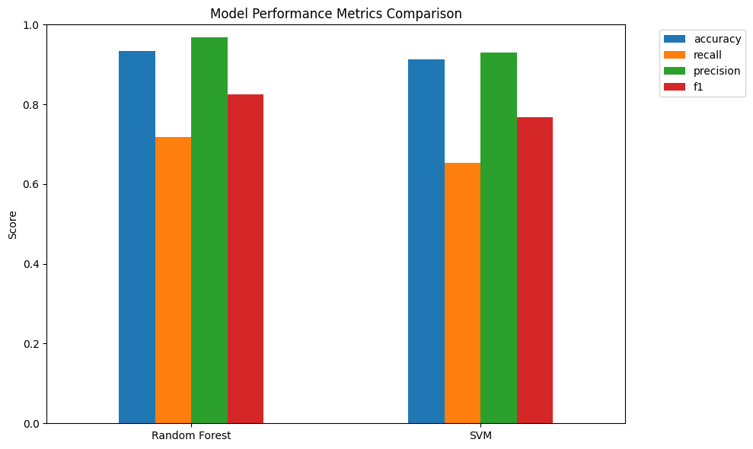
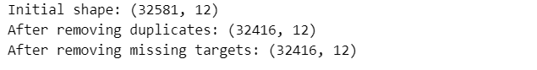
Results

Slide 11
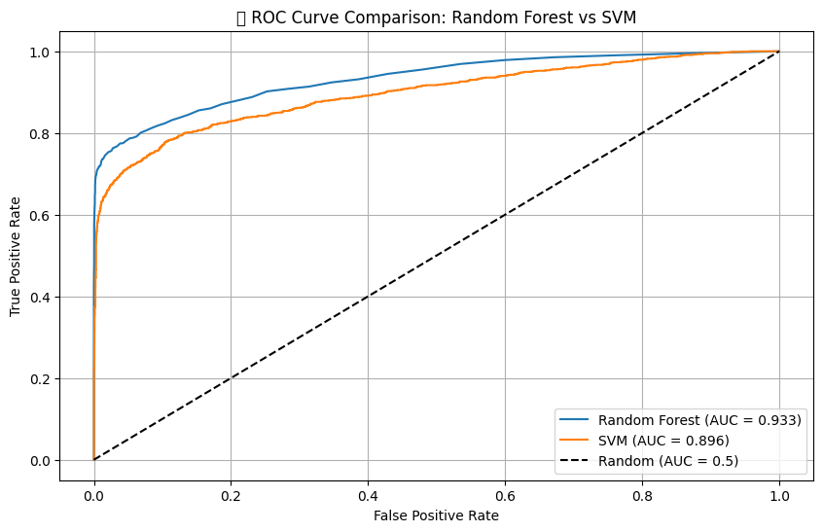
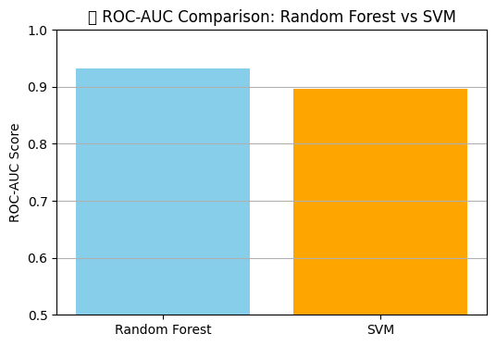
Results
Random Forest Model Accuracy:
Accuracy: 93%
SVM Model Accuracy:
Accuracy: 89%

Slide 12
Features Importance
Random Forest provides a list of important features:
loan_percent_income – how much of their income goes into loan
person_income – higher income = less risk
loan_int_rate – higher interest = higher risk
person_age – younger people may have less stable credit profiles
These help financial institutions understand why the model made a decision.

Slide 13
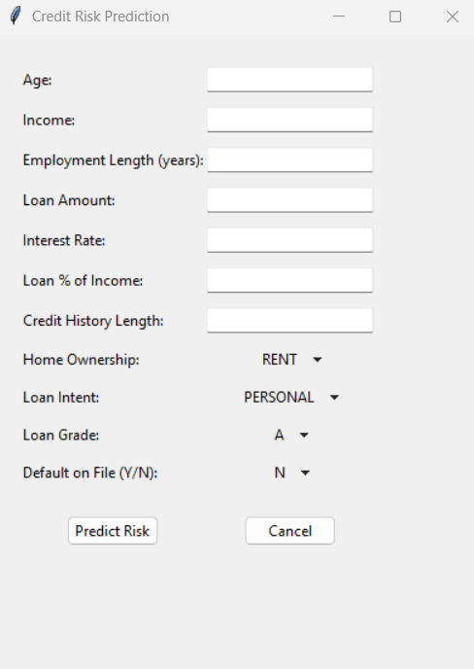
User Input Prediction Module
We built a prediction interface where users can enter:
Age, income, loan amount, interest rate, etc.
The model processes this through the same pipeline and gives:
Low Risk or High Risk
Prediction probability
This is ideal for banking apps, loan approval systems, or credit checks.

Slide 14
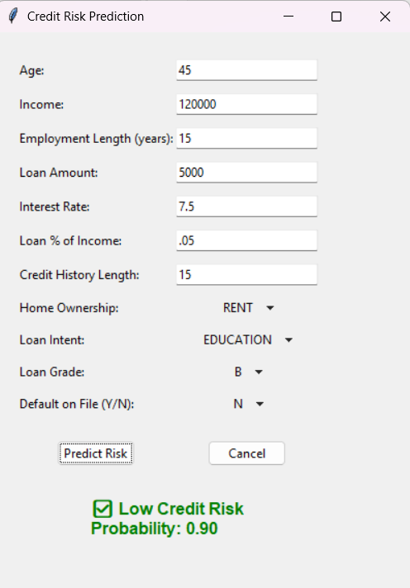
Model Deployment
Saving the Model:
- The trained Random Forest model was saved using joblib for later use in production systems.
Deployment in Financial Institutions:
This saved model can be:
Embedded into web apps
Connected to banking systems
Used for real-time loan decisions

Slide 15
Conclusion
Summary of Results:
Both Random Forest and SVM models showed promising results with high accuracy (93% and 89% respectively).
Random Forest was slightly more accurate, especially in terms of feature importance.
Developed a working machine learning pipeline for credit risk evaluation
Compared Random Forest and SVM; Random Forest performed better
Added a user input module for real-time prediction
Model is ready for deployment in real-world lending systems

Slide 16
Thank You

